Slide 1
Intelligent Agents

Slide 2
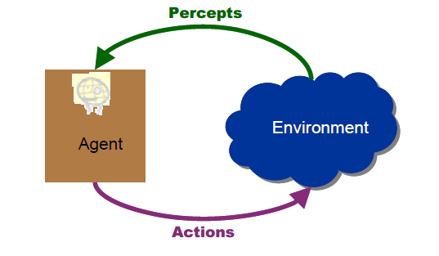
Chapter 2 Intelligent Agents
What is an agent ?
An agent is anything that perceiving its environment through sensors and acting upon that environment through actuators
Example:
Human is an agent
A robot is also an agent with cameras and motors
A thermostat detecting room temperature.

Slide 3
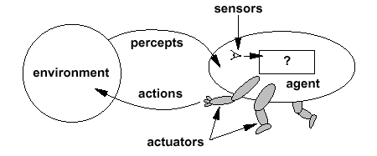
Intelligent Agents

Slide 4
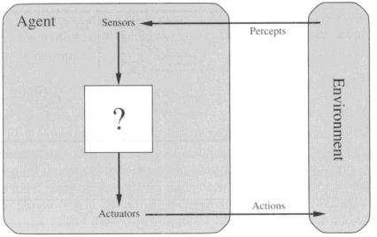
Diagram of an agent
What AI should fill

Slide 5
Agents can be classified into different types based on their characteristics, such as whether they are reactive or proactive, whether they have a fixed or dynamic environment, and whether they are single or multi-agent systems.
Reactive agents are those that respond to immediate stimuli from their environment and take actions based on those stimuli. Proactive agents, on the other hand, take initiative and plan ahead to achieve their goals.
The environment in which an agent operates can also be fixed or dynamic. Fixed environments have a static set of rules that do not change, while dynamic environments are constantly changing and require agents to adapt to new situations.
Multi-agent systems involve multiple agents working together to achieve a common goal. These agents may have to coordinate their actions and communicate with each other to achieve their objectives.
Agents are used in a variety of applications, including robotics, gaming, and intelligent systems. They can be implemented using different programming languages and techniques, including machine learning and natural language processing.

Slide 6
Examples of Agent:
There are many examples of agents in artificial intelligence. Here are a few:
Intelligent personal assistants: These are agents that are designed to help users with various tasks, such as scheduling appointments, sending messages, and setting reminders. Examples of intelligent personal assistants include Siri, Alexa, and Google Assistant.
Autonomous robots: These are agents that are designed to operate autonomously in the physical world. They can perform tasks such as cleaning, sorting, and delivering goods. Examples of autonomous robots include the Roomba vacuum cleaner and the Amazon delivery robot.
Gaming agents: These are agents that are designed to play games, either against human opponents or other agents. Examples of gaming agents include chess-playing agents and poker-playing agents.
Fraud detection agents: These are agents that are designed to detect fraudulent behavior in financial transactions. They can analyze patterns of behavior to identify suspicious activity and alert authorities. Examples of fraud detection agents include those used by banks and credit card companies.

Slide 7
Traffic management agents: These are agents that are designed to manage traffic flow in cities. They can monitor traffic patterns, adjust traffic lights, and reroute vehicles to minimize congestion. Examples of traffic management agents include those used in smart cities around the world.
A software agent has Keystrokes, file contents, received network packages which act as sensors and displays on the screen, files, sent network packets acting as actuators.
A Human-agent has eyes, ears, and other organs which act as sensors, and hands, legs, mouth, and other body parts acting as actuators.
A Robotic agent has Cameras and infrared range finders which act as sensors and various motors acting as actuators.

Slide 8
Simple Terms
Percept
Agent’s perceptual inputs at any given instant
Percept sequence
Complete history of everything that the agent has ever perceived.
In general, an agent’s choice of action at any given instant can depend on the entire percept sequence observed to date, but not on anything it hasn’t perceived.

Slide 9
Agent function & program
Agent’s behavior is mathematically described by
Agent function
A function mapping any given percept sequence to an action
We can imagine tabulating the agent function that describes any given agent; for most agents, this would be a very large table—infinite, in fact, unless we place a bound on the length of percept sequences we want to consider.
Practically it is described by
An agent program
The real implementation
The agent function is an abstract mathematical description; the agent program is a concrete implementation, running within some physical system

Slide 10
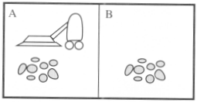
Vacuum-cleaner world
Perception: Clean or Dirty? where it is in?
Actions: Move left, Move right, suck, do nothing

Slide 11
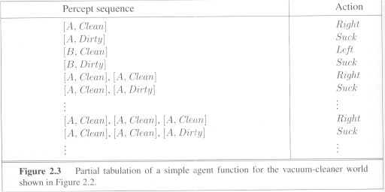
Vacuum-cleaner world

Slide 12
Program implements the agent function tabulated in Fig. 2.3
Function Reflex-Vacuum-Agent([location,status]) return an action
If status = Dirty then return Suck
else if location = A then return Right
else if location = B then return left

Slide 13
The obvious question, then, is this:
What is the right way to fill out the table?
In other words, what makes an agent good or bad, intelligent or stupid?
An Intelligent Agent must sense, must act, must be autonomous (to some extent),.
It also must be rational.
AI is about building rational agents.

Slide 14
Good Behaviour:The Concept of Rationality
Rational agent
One that does the right thing
= every entry in the table for the agent function is correct (rational).
What is correct?
The actions that cause the agent to be most successful
So we need ways to measure success.

Slide 15
Performance Measure
When an agent is plunked down in an environment, it generates a sequence of actions according to the percepts it receives.
This sequence of actions causes the environment to go through a sequence of states.
If the sequence is desirable, then the agent has performed well.
This notion of desirability PERFORMANCE is captured by a performance measure that MEASURE evaluates any given sequence of environment states.
Note: We said environment states not agent states, because if we define success in terms of agent’s opinion ,then an agent could achieve perfect rationality simply by deluding itself that its performance was perfect.

Slide 16
Performance measure
Performance measure
An objective function that determines
How the agent does successfully
E.g., 90% or 30% ?
An agent, based on its percepts
🡪 action sequence :
if desirable, it is said to be performing well.
No universal performance measure for all agents

Slide 17
Performance measure
A general rule:
Design performance measures according to
What one actually wants in the environment
Rather than how one thinks the agent should behave
E.g., in vacuum-cleaner world
We want the floor clean, no matter how the agent behave
We don’t restrict how the agent behaves
As a general rule, it is better to design performance measures according to what one actually wants in the environment, rather than according to how one thinks the agent should behave.

Slide 18
Rationality
What is rational at any given time depends on four things:
The performance measure defining the criterion of success
The agent’s prior knowledge of the environment
The actions that the agent can perform
The agents’s percept sequence up to now

Slide 19
Rational agent
For each possible percept sequence,
an rational agent should select
an action expected to maximize its performance measure, given the evidence provided by the percept sequence and whatever built-in knowledge the agent has
E.g., an exam
Maximize marks, based on
the questions on the paper & your knowledge

Slide 20
Example of a rational agent
Performance measure
Awards one point for each clean square
at each time step, over 10000 time steps
Prior knowledge about the environment
The geography of the environment
Only two squares
The effect of the actions

Slide 21
Example of a rational agent
Actions that can perform
Left, Right, Suck and NoOp
Percept sequences
Where is the agent?
Whether the location contains dirt?
Under this circumstance, the agent is rational.

Slide 22
Omniscience
An omniscient agent
Knows the actual outcome of its actions in advance and can act accordingly;
No other possible outcomes
However, impossible in real world
An example
crossing a street but died of the fallen cargo door from 33,000ft 🡪 irrational?

Slide 23
Omniscience
Based on the circumstance, it is rational.
As rationality maximizes
Expected performance
Perfection maximizes
Actual performance
Hence rational agents are not omniscient.
Rationality maximizes expected performance, while perfection maximizes actual performance.

Slide 24
Information Gathering and Exploration
Doing actions in order to modify future percepts—sometimes called information gathering—is an important part of rationality
A part from information gathering, agents must be allowed for EXPLORATION Eg:example of information gathering is provided by the exploration that must be undertaken by a vacuum-cleaning agent in an initially unknown environment.

Slide 25
Learning
Our definition requires a rational agent not only to gather information but also to learn as much as possible from what it perceives.
The agent’s initial configuration could reflect some prior knowledge of the environment, but as the agent gains experience this may be modified and augmented.
Does a rational agent depend on only current percept?
No, the past percept sequence should also be used
This is called learning
After experiencing an episode, the agent
should adjust its behaviors to perform better for the same job next time.

Slide 26
Autonomy
If an agent just relies on the prior knowledge of its designer rather than its own percepts then the agent lacks autonomy
A rational agent should be autonomous- it should learn what it can to compensate for partial or incorrect prior knowledge.
E.g., a vacuum-cleaning agent that learns to foresee where and when additional
dirt will appear will do better than one that does not.

Slide 27
As a practical matter, one seldom requires complete autonomy from the start: when the agent has had little or no experience, it would have to act randomly unless the designer gave some assistance.

Slide 28
Software Agents
Sometimes, the environment may not be the real world
E.g., flight simulator, video games, Internet
They are all artificial but very complex environments
Those agents working in these environments are called
Software agent (softbots)
Because all parts of the agent are software

Slide 29
Task environments
Task environments are the problems
While the rational agents are the solutions
Specifying the task environment
PEAS description as fully as possible
Performance
Environment
Actuators
Sensors
In designing an agent, the first step must always be to specify the task environment as fully as possible.
Use automated taxi driver as an example

Slide 30
Task environments
Performance measure
How can we judge the automated driver?
Which factors are considered?
getting to the correct destination
minimizing fuel consumption
minimizing the trip time and/or cost
minimizing the violations of traffic laws
maximizing the safety and comfort, etc.

Slide 31
Task environments
Environment
A taxi must deal with a variety of roads
Traffic lights, other vehicles, pedestrians, stray animals, road works, police cars, etc.
Interact with the customer

Slide 32
Task environments
Actuators (for outputs)
Control over the accelerator, steering, gear shifting and braking
A display to communicate with the customers
Sensors (for inputs)
Detect other vehicles, road situations
GPS (Global Positioning System) to know where the taxi is
Many more devices are necessary

Slide 33
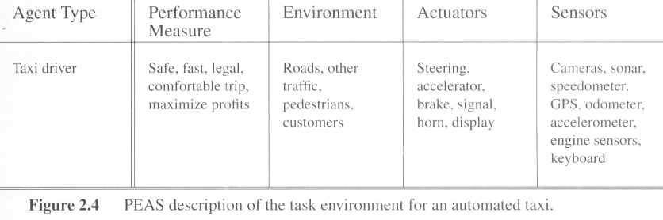
Task environments
A sketch of automated taxi driver

Slide 34
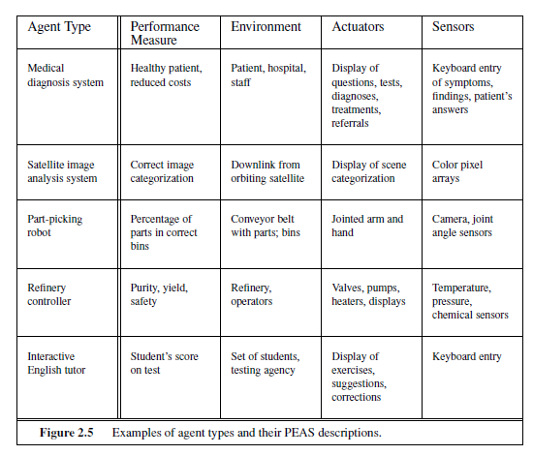

Slide 35
Properties of task environments
Fully observable vs. Partially observable
If an agent’s sensors give it access to the complete state of the environment at each point in time then the environment is effectively and fully observable
if the sensors detect all aspects
That are relevant to the choice of action
In such environments, the agent does not need to keep track of the changes in the environment.
A chess playing system is an example of a system that operates in a fully observable environment.

Slide 36
Partially observable
An environment might be Partially observable because of noisy and inaccurate sensors or because parts of the state are simply missing from the sensor data.
Example:
A local dirt sensor of the cleaner cannot tell
Whether other squares are clean or not
If the agent doesn’t have any sensors, then it is unobservable

Slide 37
Properties of task environments
Deterministic vs. stochastic
next state of the environment Completely determined by the current state and the actions executed by the agent, then the environment is deterministic, otherwise, it is Stochastic. Image analysis systems are examples of this kind of situation. The processed image is determined completely by the current image and the processing operations.
An agent needn’t worry about uncertainty in a deterministic and fully observable environment
Strategic environment: deterministic except for actions of other agents
-Cleaner and taxi driver are:
Stochastic because of some unobservable aspects 🡪 noise or unknown
Uncertain- neither fully observable nor deterministic

Slide 38
If the environment state is wholly determined by the preceding state and the actions of multiple agents, then the environment is said to be strategic. Example: Chess. There are two agents, the players and the next state of the board is strategically determined by the players’ actions.

Slide 39
Properties of task environments
Episodic vs. sequential
An episode = agent’s single pair of perception & action
The quality of the agent’s action does not depend on other episodes
Every episode is independent of each other
Episodic environment is simpler
The agent does not need to think ahead
For example, an agent that has to spot defective parts on an assembly line bases each decision on the current part, regardless of previous decisions; moreover, the current decision doesn’t affect whether the next part is defective
Sequential
Current action may affect all future decisions
-Ex. Taxi driving and chess.

Slide 40
Properties of task environments
Static vs. dynamic
A dynamic environment is always changing over time
E.g., the number of people in the street
While static environment
E.g., the destination
The only changes to the environment are those caused by the agent itself.
• A static environment does not change while the agent is thinking.
• The passage of time as an agent deliberates is irrelevant.
• The agent doesn’t need to observe the world during deliberation.
Static environments are easy to deal with because the agent need not keep looking at the world while it is deciding on an action, nor need it worry about the passage of time.
Dynamic environments, on the other hand, are continuously asking the agent what it wants to do; if it hasn’t decided yet, that counts as deciding to do nothing.
Semidynamic
environment is not changed over time
but the agent’s performance score does

Slide 41
Properties of task environments
Discrete vs. continuous
The discrete/continuous distinction applies to the state of the CONTINUOUS environment, to the way time is handled, and to the percepts and actions of the agent.
If there are a limited number of distinct states, clearly defined percepts and actions, the environment is discrete
E.g., Chess game
Continuous: Taxi driving -continuously varying intensities and locations.

Slide 42
Properties of task environments
Single agent VS. multiagent
Playing a crossword puzzle – single agent
Chess playing – two agents
Competitive multiagent environment
Chess playing
Cooperative multiagent environment
Automated taxi driver
Avoiding collision

Slide 43
Properties of task environments
Known vs. unknown
This distinction refers not to the environment itslef but to the agent’s (or designer’s) state of knowledge about the environment.
-In known environment, the outcomes for all actions are
given. ( example: solitaire card games).
- If the environment is unknown, the agent will have to learn how it works in order to make good decisions.( example: new video game).

Slide 44
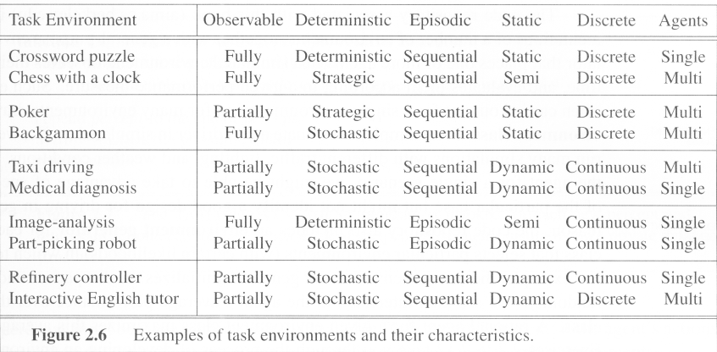
Examples of task environments

Slide 45
Structure of agents

Slide 46
Structure of agents
Agent = architecture + program
Architecture = some sort of computing device (sensors + actuators)
(Agent) Program = some function that implements the agent mapping = “?”
Agent Program = Job of AI

Slide 47
Agent programs
Input for Agent Program
Only the current percept
Input for Agent Function
The entire percept sequence
The agent must remember all of them
Implement the agent program as
A look up table (agent function)

Slide 48
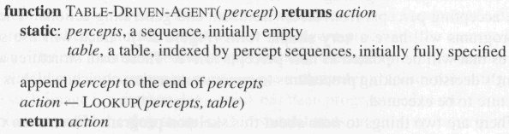
Agent programs
Skeleton design of an agent program

Slide 49
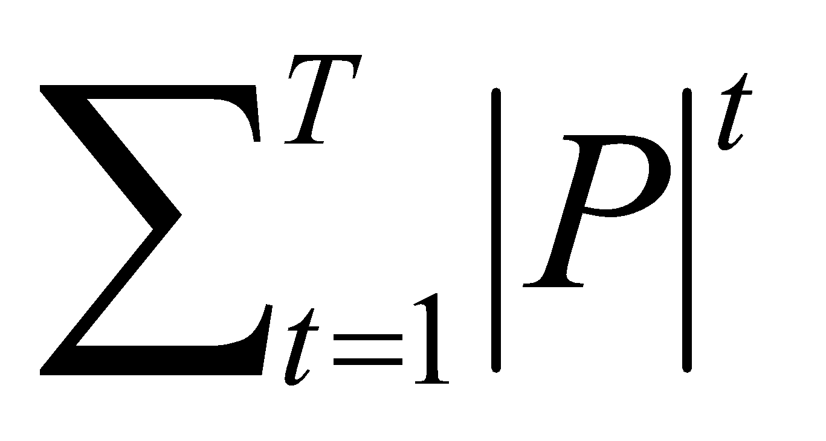
Agent Programs
P = the set of possible percepts
T= lifetime of the agent
The total number of percepts it receives
Size of the look up table
Consider playing chess
P =10, T=150
Will require a table of at least 10¹⁵⁰ entries

Slide 50
Agent programs
Despite of huge size, look up table does what we want.
The key challenge of AI
Find out how to write programs that, to the extent possible, produce rational behavior
From a small amount of code
Rather than a large amount of table entries
E.g., a five-line program of Newton’s Method
V.s. huge tables of square roots, sine, cosine, …

Slide 51
Types of agent programs
Four types
Simple reflex agents
Model-based reflex agents
Goal-based agents
Utility-based agents

Slide 52
The simplest kind of agent is the simple reflex agent. These agents select actions on the basis of the current percept, ignoring the rest of the percept history.

Slide 53
Simple reflex agents
It uses just condition-action rules
The rules are like the form “if … then …”
efficient but have narrow range of applicability
Because knowledge sometimes cannot be stated explicitly
Work only
if the environment is fully observable

Slide 54
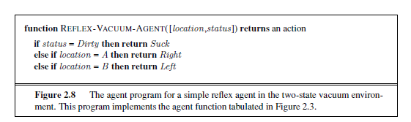

Slide 55
Simple reflex behaviors occur even in more complex environments.
Imagine yourself as the driver of the automated taxi. If the car in front brakes and its brake lights come on, then you should notice this and initiate braking.
In other words, some processing is done on the visual input to establish the condition we call “The car in front is braking.”
Then, this triggers some established connection in the agent program to the action “initiate braking.”
We call CONDITION–ACTION such a connection a condition–action rule.

Slide 56
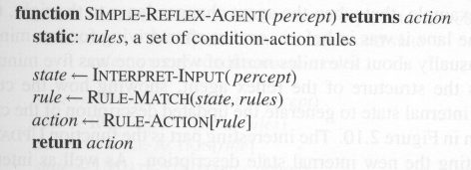
Simple reflex agents

Slide 58
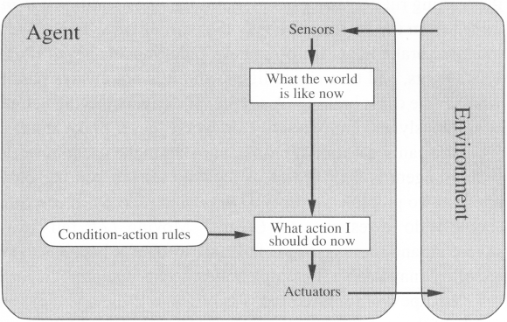
Simple reflex agents (2)

Slide 59
Simple reflex agents have the admirable property of being simple, but they turn out to be of limited intelligence.
The agent will work only if the correct decision can be made on the basis of only the current percept—that is, only if the environment is fully observable.
Even a little bit of unobservability can cause serious trouble.

Slide 60
Model-based Reflex Agents
For the world that is partially observable
the agent has to keep track of an internal state
That depends on the percept history
Reflecting some of the unobserved aspects
E.g., driving a car and changing lane
Requiring two types of knowledge
How the world evolves independently of the agent
How the agent’s actions affect the world

Slide 61
Example Table Agent With Internal State
IF
THEN
Saw an object ahead, and turned right, and it’s now clear ahead | Go straight
Saw an object Ahead, turned right, and object ahead again | Halt
See no objects ahead | Go straight
See an object ahead | Turn randomly

Slide 62
Example Reflex Agent With Internal State: Wall-Following
start
Actions: left, right, straight, open-door
Rules:
If open(left) & open(right) and open(straight) then
choose randomly between right and left
If wall(left) and open(right) and open(straight) then straight
If wall(right) and open(left) and open(straight) then straight
If wall(right) and open(left) and wall(straight) then left
If wall(left) and open(right) and wall(straight) then right
If wall(left) and door(right) and wall(straight) then open-door
If wall(right) and wall(left) and open(straight) then straight.
(Default) Move randomly

Slide 63
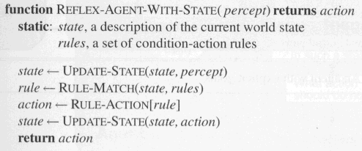
Model-based Reflex Agents
The agent is with memory

Slide 64
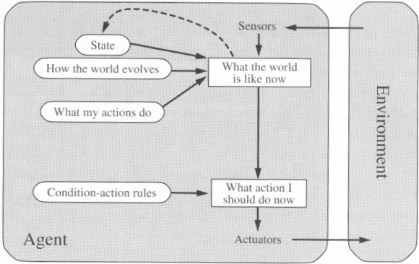
Model-based Reflex Agents

Slide 65
Goal-based agents
Current state of the environment is always not enough
The goal is another issue to achieve
Judgment of rationality / correctness
Actions chosen 🡪 goals, based on
the current state
the current percept

Slide 66
Goal-based agents
Conclusion
Goal-based agents are less efficient
but more flexible
Agent 🡨 Different goals 🡨 different tasks
Search and planning
two other sub-fields in AI
to find out the action sequences to achieve its goal

Slide 67
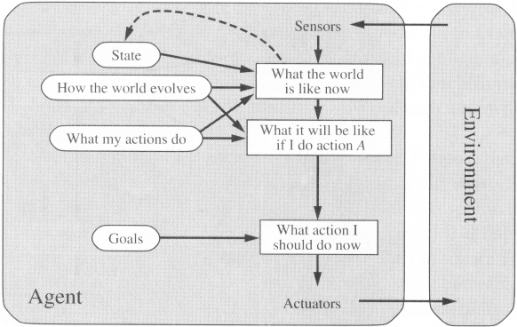
Goal-based agents

Slide 68
Utility-based agents
Goals alone are not enough
to generate high-quality behavior
E.g. meals in Canteen, good or not ?
Many action sequences 🡪 the goals
some are better and some worse
If goal means success,
then utility means the degree of success (how successful it is)
An agent’s utility function is essentially an internalization of the performance measure.
If the internal utility function and the external performance measure are in agreement, then an agent that chooses actions to maximize its utility will be rational according to the external performance measure.

Slide 69
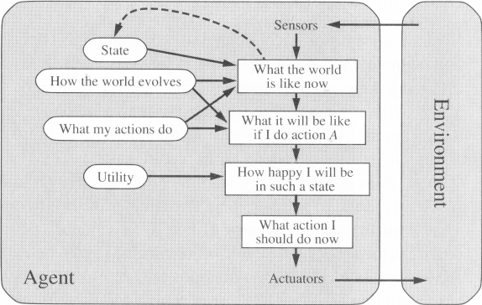
Utility-based agents (4)

Slide 70
Utility-based agents
it is said state A has higher utility
If state A is more preferred than others
Utility is therefore a function
that maps a state onto a real number
the degree of success

Slide 71
Utility-based agents (3)
Utility has several advantages:
When there are conflicting goals,
Only some of the goals but not all can be achieved
utility describes the appropriate trade-off
When there are several goals
None of them are achieved certainly
utility provides a way for the decision-making

Slide 72
Learning Agents
After an agent is programmed, can it work immediately?
No, it still need teaching
In AI,
Once an agent is done
We teach it by giving it a set of examples
Test it by using another set of examples
We then say the agent learns
A learning agent

Slide 73
Learning Agents
Four conceptual components
Learning element
Making improvement
Performance element
Selecting external actions
Critic
Tells the Learning element how well the agent is doing with respect to fixed performance standard.
(Learning element takes Feedback from critic on how agent is doing and how performance element should be modified for better future actions)
Problem generator
Suggest actions that will lead to new and informative experiences.

Slide 74
The design of the learning element depends very much on the design of the performance element.
When trying to design an agent that learns a certain capability, the first question is not “How am I going to get it to learn this?” but “What kind of performance element will my agent need to do this once it has learned how?”
The critic is necessary because the percepts themselves provide no indication of the agent’s success.Eg: Chess Program
The last component of the learning PROBLEM agent is the problem generator. It is responsible GENERATORfor suggesting actions that will lead to new and informative experiences.
The point is that if the performance element had its way, it would keep doing the actions that are best, given what it knows.
But if the agent is willing to explore a little and do some perhaps suboptimal actions in the short run, it might discover much better actions for the long run.
The problem generator’s job is to suggest these exploratory actions.

Slide 75
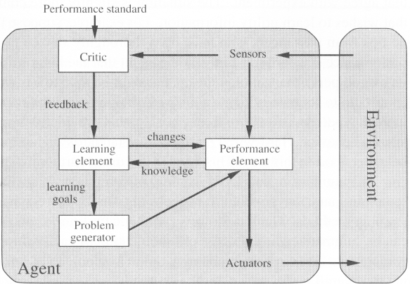
Learning Agents

Slide 76
The situation is slightly more complex for a utility-based agent that wishes to learn utility information. For example, suppose the taxi-driving agent receives no tips from passengers who have been thoroughly shaken up during the trip.
The external performance standard must inform the agent that the loss of tips is a negative contribution to its overall performance;
Then the agent might be able to learn that violent maneuvers do not contribute to its own utility.
In a sense, the performance standard distinguishes part of the incoming percept as a reward (or penalty) that provides direct feedback on the quality of the agent’s behavior.

Slide 77
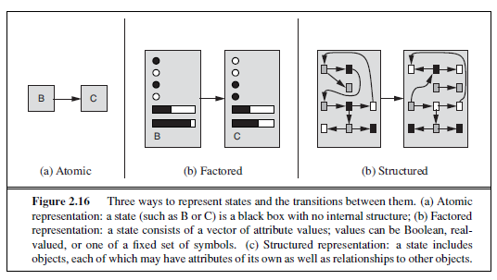
How the components of agent programs work?

Slide 78
In an atomic representation each state of the world is indivisible-it has no internal structure.
For the purposes of solving a problem, it may suffice to reduce the state of world to just the name o—a single atom of knowledge; a “black box” whose only discernible property is that of being identical to or different from another black box.
Eg:search and game playing, hidden Markov all work with atomic representations—or, at least, they treat representations as if they were atomic.
Factored representation splits up each state into a fixed set of variables or attributes, each of which can have a value.
With factored representations, we can also represent uncertainty—for example, ignorance about the amount of gas in the tank can be represented by leaving that attribute blank. Many important areas of AI are based on factored representations, including constraint satisfaction algorithms, Bayesian network etc

Slide 79
For many purposes, we need to understand the world as having things in it that are related to each other, not just variables with values.
For example, we might notice that alarge truck ahead of us is reversing into the driveway of a dairy farm but a cow has got looseand is blocking the truck’s path.
Instead, we would need a structured representation, in which objects such as cows and trucks and their various and varying relationships can be described explicitly.
relational databases and first-order logic , first-order probability models knowledge-based learning ,and much of natural language understanding
In fact, almost everything that humans express in natural language concerns objects and their relationships.

Slide 80
the axis along which atomic, factored, and structured repre sentations lie is the axis of increasing expressiveness.
Roughly speaking, a more expressive representation can capture, at least as concisely, everything a less expressive one can capture,plus some more.

